Slide 1


Student follow up
Visual Company Part 2 Group-5

Slide 2



The challenges of being a Product Owner for my team
Huymey
Try to understand customer needs
Communication with scrum master

Slide 3








What did I have learn during the VC
Huymey
Softs Skill
Hards Skill
How to contact with customer
Learn more about figma
How to communication with customer
Know about User Story
Explain and discussion with scrum
Learn more about researching skill
Solving problem

Slide 4
What I need to improve for the future
Huymey
Find more information for the project
Improve more for User experiences
Find more question for ask customer

Slide 5
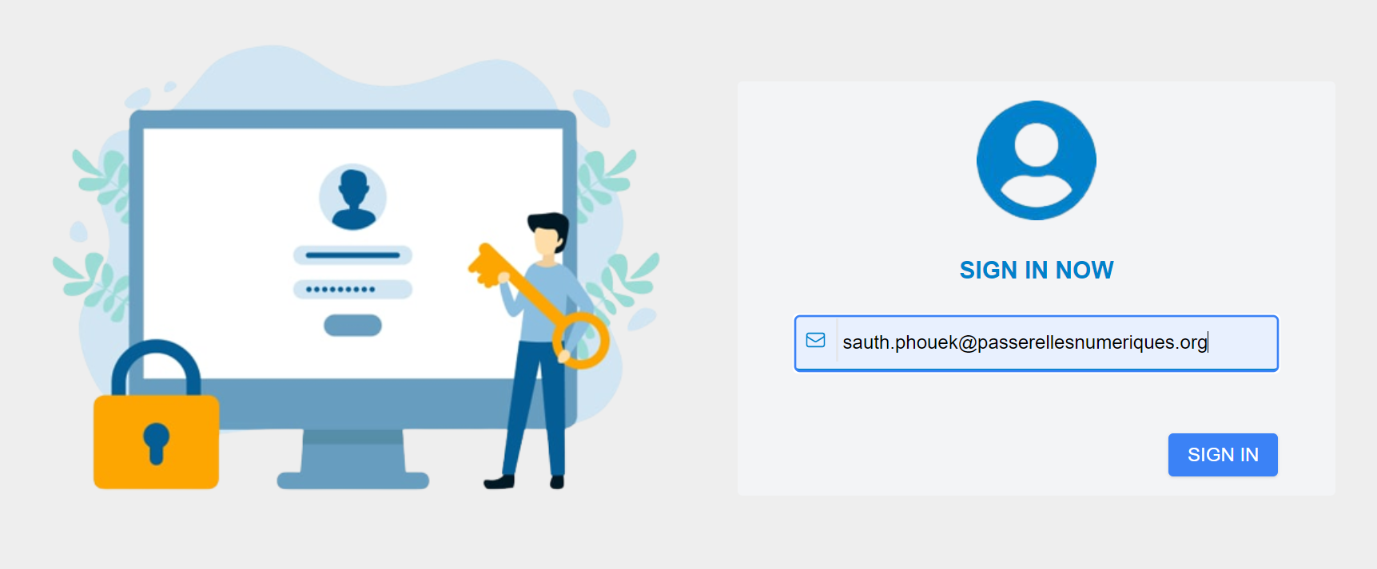

Soklim
LOGIN AND LOGOUT

Slide 6
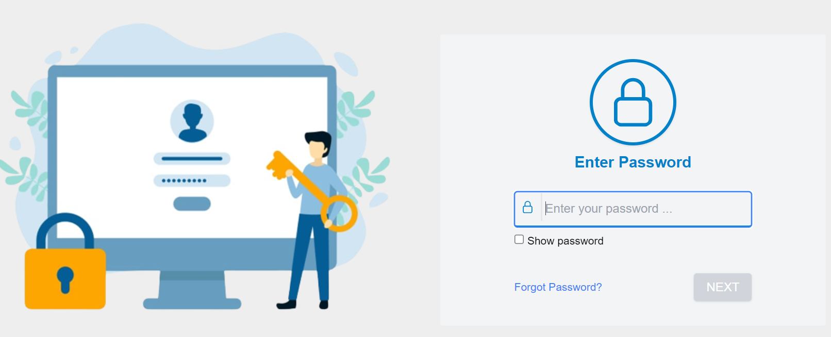
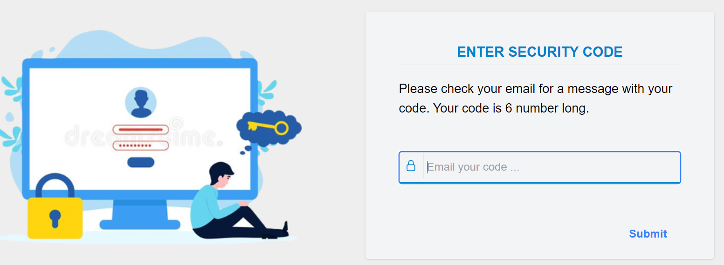
Soklim
Enter Password and forget password

Slide 7
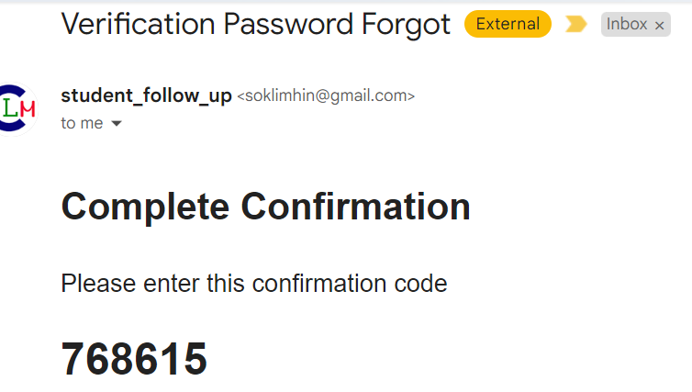
Soklim
Enter Password and forget password

Slide 8
Soklim
What I have learn during project
Hard skills
Know about Cookie
Know about widget
Soft skills
Team work
Communication
Task management

Slide 9
Sreykea
The feature of crud teacher
Crud teacher
Add teacher
Delete
See all teacher
Search

Slide 10
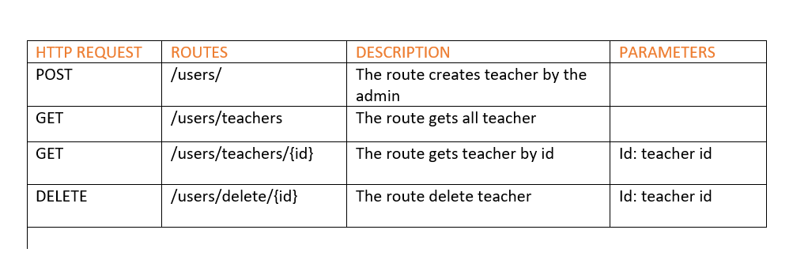
Sreykea
Route of teacher

Slide 11
Sreykea
What I have learn during project
Hard skills
Fetch data API
Know about widget
Know about view
Soft skills
Team work
Communication
Task management

Slide 12
Sreykea
What I want to improve for the next time
Task management
Researching skill
time management

Slide 13
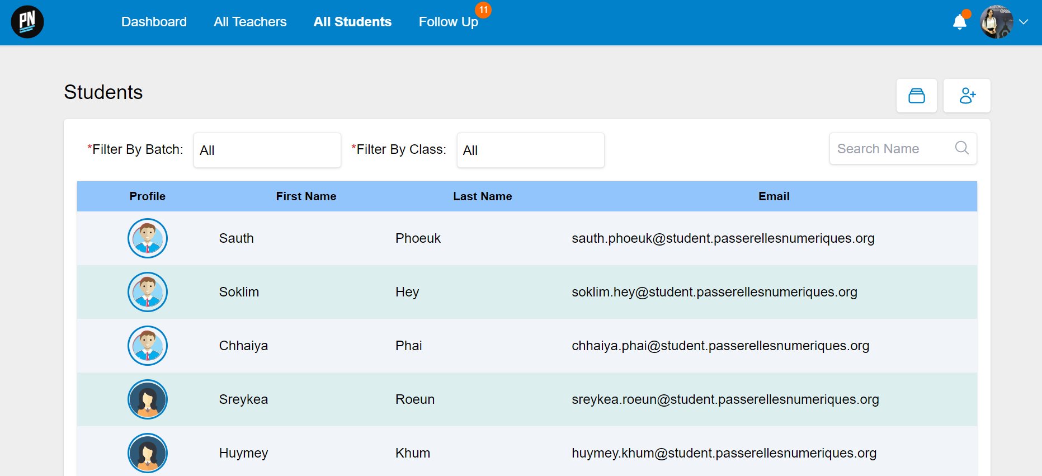
LIST OF STUDENTS
Sopheap

Slide 14
Crud of students
Sopheap
Crud of students
Create students
Edit of students
Delete of students
See list and search of students

Slide 15
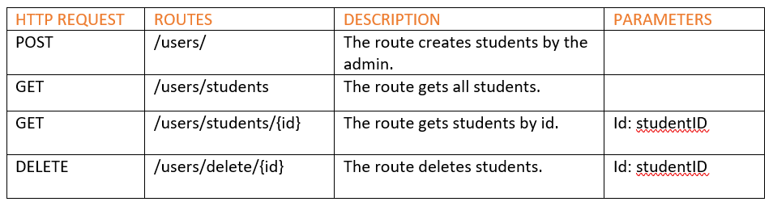
Route of students
Sopheap

Slide 16
Sopheap
What I have learn during project
Soft skills
Team work
Communication
Identify key challenges
Task management
Time management
Hard skills
Fetch data API
Know more of widget
Know more of view

Slide 17
Sopheap
What I need to improve of the future
Research and fast to understand
Manage the time
Find solution
Organizing during project

Slide 18
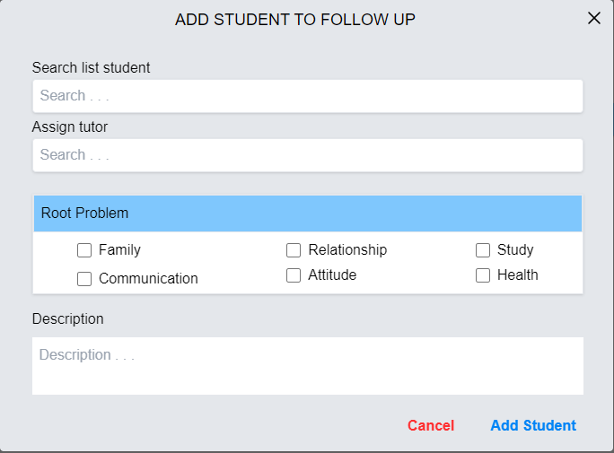
ADD STUDENT TO FOLLOW UP
Chhaiya

Slide 19
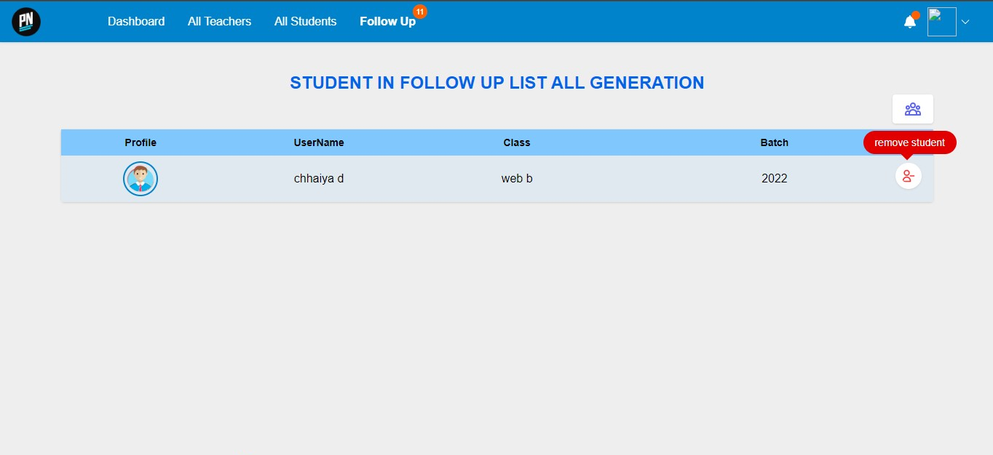
REMOVE STUDENT FROM FOLLOW UP
Chhaiya

Slide 20
What I have learnt from this VC
Chhaiya
Hard skills
Soft skills
How to use Widget components
Improve at Vue and Laravel
Know how back end and front end work
Team work
Time management
Problem solving

Slide 21
What I need to improve next time
Chhaiya
More active in team
Researching
Completing tasks

Slide 22
Sauth
Task assignment
Sprint 1
Sprint 2
Soklim
Crud teachers
Login & logout
Sreykea
Create widget
Crud student
Crud student follow up
Chhaiya
Crud students
Crud students
Sopheap
Create form edit
Login view

Slide 23
Sauth
The challenges being a scrum master
Assign the task to member
Seperate the task
Merge branch

Slide 24
Sauth
What I have learn during project
Soft skills
Communication
Time management
Task management
Responsibility
Delivery the task to member
Hard skills
Tailwind css
How to store data in vuex

Slide 25
Sauth
What I want to improve in future
Motivate member
Assign task
Critical thinking
Find new more features
Communication

Slide 26


Slide 27


